Slide 1
MODULE 2
Design Thinking Approach:-Introduction to Design Thinking,
Iterative Design Thinking Process Stages: Empathize, Define, Ideate, Prototype and Test.
Design Thinking as Divergent-Convergent Questioning.
Design Thinking in a Team Environment.

Slide 2
Introduction to Design Thinking
Design Thinking is simply a process of creative problem solving.
Design thinking is a non-linear, iterative process that teams use to understand users, challenge assumptions, redefine problems and create innovative solutions to prototype and test.
It is most useful to tackle problems that are ill-defined or unknown.
It involves five phases—
Empathize
Define
Ideate
Prototype
Test.

Slide 3
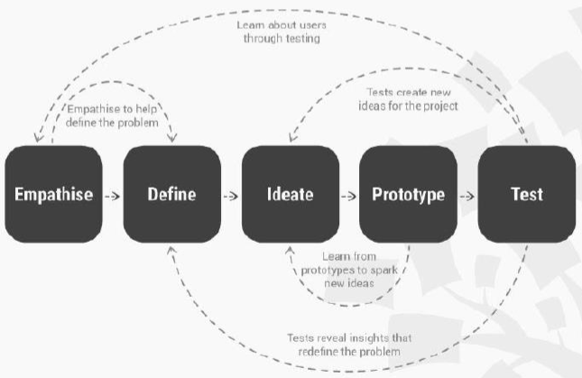
Iterative Design Thinking Process Stages
It involves five phases—Empathize, Define, Ideate, Prototype and Test.
Note: These stages are not always sequential, and teams often run them in parallel, out of order and repeat them in an iterative fashion.

Slide 4
1. Empathize - Research your users needs
It is the first step in design thinking because it is a skill that allows us to understand and share the same feelings that others feel. Through empathy, we are able to put ourselves in other people's shoes and connect with how they might be feeling about their problem, circumstance, or situation.
Designer should gain an empathetic understanding of the problem that they are trying to solve, typically through user research.
Empathy is crucial to a human centered design process such as design thinking because it allows you to set aside your own assumptions about the world and gain real insight into users and their needs.
Depending on time constraints, a substantial amount of information is gathered at this stage to use during the next stage and to develop the best possible understanding of the users, their needs, and the problems that underlie the development of that particular product.

Slide 5
3 steps
1) Observe
How users interact with their environment.
Capture quotes, behaviors and other notes that reflect their experience.
Notice what they think, feel, need
2) Engage
Interviews scheduled or ad-hoc
Learn how to ask the right questions
3) Immerse
Find ways “to get into the user’s shoes”
Best way to understand the users’ needs

Slide 6
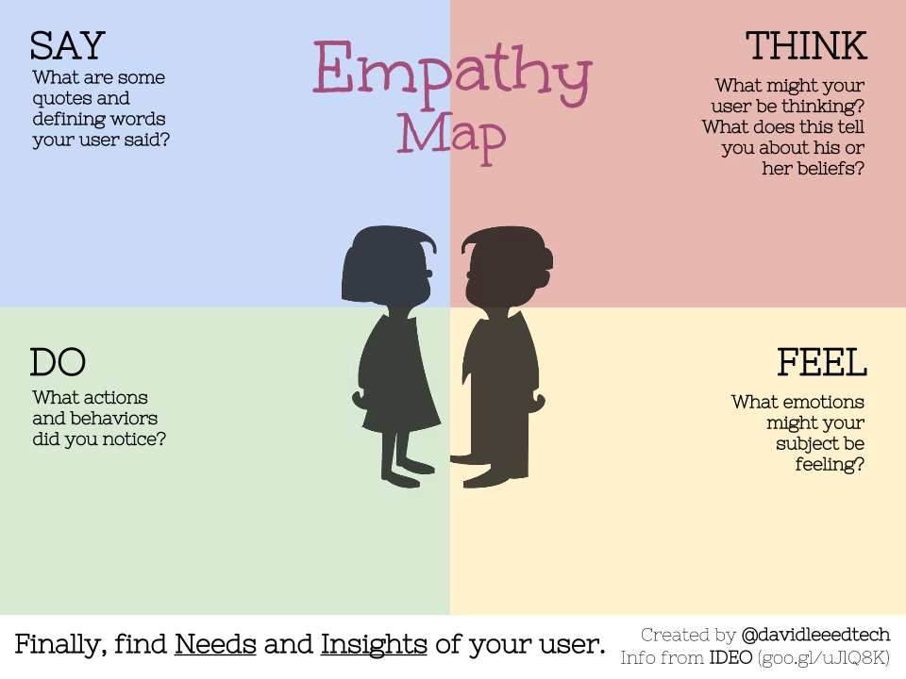
Empathy Map

Slide 7
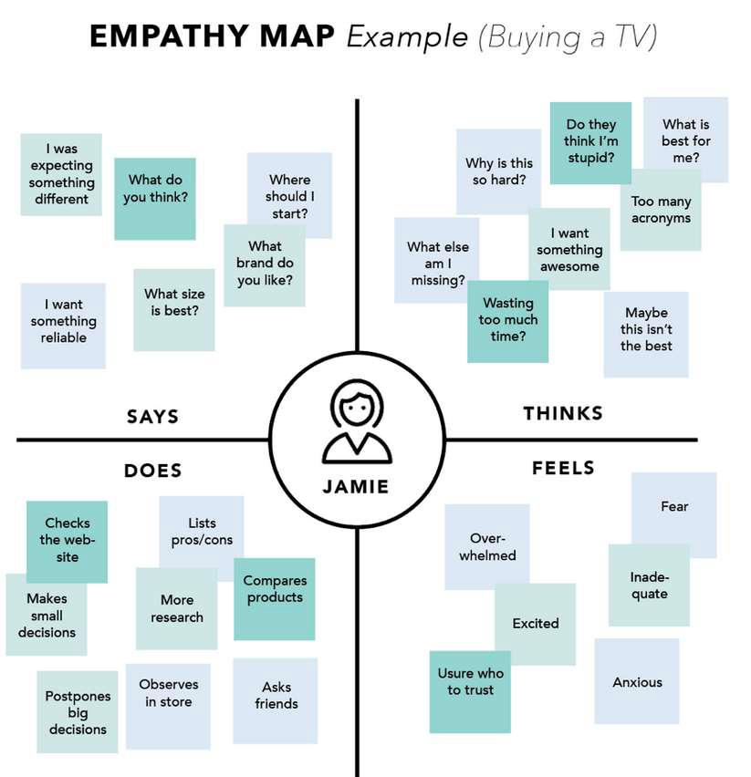

Slide 8
2. Define – State your users needs and problems.
During the Define stage, you put together the information you have created and gathered during the Empathize stage.
Then analyze your observations and synthesize them to define the core problems you and your team have identified up to this point. These definitions are called problem statements.
Problem statements are concise descriptions of design problems. It should be clear and unambiguous.

Slide 9
Define tools
Point of view
You articulate a POV by combining these three elements – user, need, and insight.
How Might We
Short questions that launch brainstorms
Why-How Ladder
Used to find user needs and ways to possibly solve them

Slide 10
3. Ideate – Challenge Assumptions and create ideas
The solid background of knowledge from the first two phases means you can start to think outside the box, look for alternative ways to view the problem and identify innovative solutions to the problem statement you have created.
It is important to get as many ideas or problem solutions as possible at the beginning of the Ideation phase.
Brainstorming is particularly useful here.
Brainstorming is a method design teams use to generate ideas to solve clearly defined design problems.
Identify the assumptions you have about the product you are building and challenge these assumptions.
Very important step if the empathy stage wasn’t well done and there were many things assumed about the users and their context

Slide 11
How to ideate
Ideate=transition from identifying problems to exploring solutions
Ideation is leveraged to:
Harness the collective perspectives and strengths of your team.
Step beyond obvious solutions and drive innovation.
Uncover unexpected areas of exploration.
Create fluency (volume) and flexibility (variety) in your innovation options.

Slide 12
Tools to ideate
Brainstorm
Braindump
Brainwrite
Brainwalk
Challenge Assumptions
SCAMPER
Mindmap
Sketch or Sketchstorm
Storyboard
Analogies
Provocation
Movement
Bodystorm
Gamestorming
Cheatstorm
Crowdstorm
Co-Creation Workshops
Power of Ten
Prototype
Creative Pause

Slide 13
4. Prototype – Start to create solutions
This is an experimental phase.
The aim is to identify the best possible solution for each problem found.
Team should produce some inexpensive, scaled down versions of the product (or specific features found within the product) to investigate the ideas they have generated. This could involve simulations, 3D models, animations etc.
The solutions are implemented within the prototypes, and, one by one, they are investigated and either accepted, improved and re examined, or rejected on the basis of the users experiences.
Prototypes may be shared and tested within the team itself, in other departments, or on a small group of people outside the design team.
By the end of this stage, the design team will have a better idea of the constraints inherent to the product and the problems that are present, and have a clearer view of how real users would behave, think, and feel when interacting with the end product.

Slide 14
5. Test – Try out your solutions
Evaluators rigorously test the prototypes.
During this phase, alterations and refinements are made in order to rule out problem solutions and derive a deep understanding of the product and its users as much as possible.
Although this is the final phase, design thinking is iterative: Teams often use the results to redefine one or more further problems.
They can return to previous stages to make further alterations and refinements –to find or rule out alternative solutions and choose the best one.

Slide 15
Testing with users
Allows you to learn about the solution you created but also about the users (builds empathy)
Let your user experience the prototype.
Show don’t tell. Put your prototype in the user’s hands (or your user in the prototype) and give only the basic context they need to understand what to do.
Have them talk through their experience.
Use prompts. “Tell me what you’re thinking as you do this.”
Actively observe.
Don’t immediately “correct” your user.
Watch how they use (and misuse) your prototype.
Follow up with questions.
This is often the most valuable part.

Slide 16
Case Study
Q) Illustrate a design thinking approach for designing a bag for college students within a limited budget. Describe each stage of the process and the iterative procedure involved. Use hand sketches to support your argument.

Slide 19
Design Thinking as Divergent-Convergent Questioning

Slide 24
Design Thinking in a Team Environment

Slide 25
Characteristics of an effective team are:
Steps in resolving Conflicts
Prepare the resolution
Understand the situation
Reach Agreement

Slide 30
Case Study – Drug Trolley in Hospitals
Q) Construct a number of possible designs and then refine them to narrow down to the best design for a drug trolley used in hospitals. Show how the divergent-convergent thinking helps in the process. Provide your rationale for each step by using hand sketches only.

Slide 36
KTU University Questions
Discuss how to manage the conflicts in a team executing the design thinking process. [3 marks]
How does the design thinking approach help engineers in creating innovative and efficient designs? [3 marks]
Describe the iterative process involved in design thinking approach [3 marks]
Describe the importance of empathize phase in design thinking [3 marks]
Design a water bottle that can be opened with one hand. Illustrate the various stages involved in design thinking. Sketch the final design. [14 marks]
During the Covid-19 pandemic, people have to wear a mask, but wearing a mask is not comfortable. Empathize about this design problem and arrive at a solution using the design thinking process, so that people can select the level of protection provided by masks according to different situations. Illustrate the solution using sketches. [14 marks]
Illustrate the design thinking approach for designing a wearable technology for a college student. Describe each stage of the process. [14 marks]
Illustrate the solution using sketches. Some of the vehicle drivers do not dim the headlights when facing another vehicle at night. Empathize about this design problem and arrive at a solution using the design thinking process. Illustrate the solution using sketches. [14 marks]

